Slide 1
Computer Networksks
Khizar Mukhtiar
Department of Computer Science
National University of Computer & Emerging Sciences

Slide 2
Application Layer contd.

Slide 3
Recap
Communication between processes
HTTP:
  “Stateless”
  Persistent vs Non-persistent

Slide 4
Other HTTP request messages
POST method:
web page often includes form input
user input sent from client to server in entity body of HTTP POST request message
HEAD method:
requests headers (only) that would be returned if specified URL were requested with an HTTP HEAD method.
PUT method:
uploads new file (object) to server
completely replaces file that exists at specified URL with content in entity body of PUT HTTP request message
GET method (for sending data to server):
include user data in URL field of HTTP GET request message (following a ‘?’):
www.somesite.com/animalsearch?monkeys&banana

Slide 5
HTTP response message
status line (protocol
status code status phrase)
HTTP/1.1 200 OK
Date: Tue, 08 Sep 2020 00:53:20 GMT
Server: Apache/2.4.6 (CentOS) OpenSSL/1.0.2k-fips PHP/7.4.9 mod_perl/2.0.11 Perl/v5.16.3
Last-Modified: Tue, 01 Mar 2016 18:57:50 GMT
ETag: "a5b-52d015789ee9e"
Accept-Ranges: bytes
Content-Length: 2651
Content-Type: text/html; charset=UTF-8
\r\n
data data data data data ...
header
lines
data, e.g., requested
HTML file

Slide 6
HTTP response status codes
status code appears in 1st line in server-to-client response message.
some sample codes:
200 OK
  request succeeded, requested object later in this message
301 Moved Permanently
  requested object moved, new location specified later in this message (in Location: field)
400 Bad Request
  request msg not understood by server
404 Not Found
  requested document not found on this server
505 HTTP Version Not Supported

Slide 7


Maintaining user/server state: cookies
Recall: HTTP GET/response interaction is stateless
no notion of multi-step exchanges of HTTP messages to complete a Web “transaction”
  no need for client/server to track “state” of multi-step exchange
  all HTTP requests are independent of each other
  no need for client/server to “recover” from a partially-completed-but-never-completely-completed transaction
a stateful protocol: client makes two changes to X, or none at all
X
lock data record X
X
OK
update X X’
X’
OK
t’
update X X’’
OK
X’’
unlock X
OK
X’’
time
time
Q: what happens if network connection or client crashes at t’ ?
Notes:
t’

Slide 8
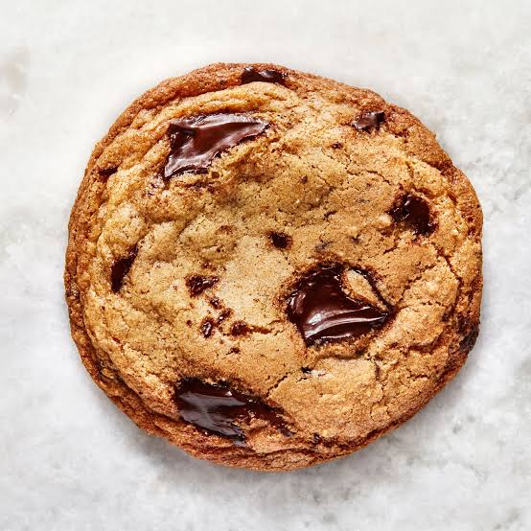
Maintaining user/server state: cookies
Web sites and client browser use cookies to maintain some state between transactions
four components:
  1) cookie header line of HTTP response message
  2) cookie header line in next HTTP request message
  3) cookie file kept on user’s host, managed by user’s browser
  4) back-end database at Web site
Example:
Alice uses browser on laptop, visits specific e-commerce site for first time
when initial HTTP requests arrives at site, site creates:
  unique ID (aka “cookie”)
  entry in backend database for ID
subsequent HTTP requests from Alice to this site will contain cookie ID value, allowing site to “identify” Alice
Notes:
t’

Slide 9
Maintaining user/server state: cookies
client
Amazon server
ebay 8734
usual HTTP request msg
Amazon server
creates ID
1678 for user
cookie file
usual HTTP response
set-cookie: 1678
backend
database
create
entry
ebay 8734
amazon 1678
usual HTTP request msg
cookie: 1678
cookie-
specific
action
access
usual HTTP response msg
one week later:
access
ebay 8734
amazon 1678
usual HTTP request msg
cookie: 1678
cookie-
specific
action
usual HTTP response msg
time
time
Notes:
t’

Slide 10
HTTP cookies: comments
aside
What cookies can be used for:
authorization
shopping carts
recommendations
user session state (Web e-mail)
cookies and privacy:
cookies permit sites to learn a lot about you on their site.
third party persistent cookies (tracking cookies) allow common identity (cookie value) to be tracked across multiple web sites
Challenge: How to keep state?
at protocol endpoints: maintain state at sender/receiver over multiple transactions
in messages: cookies in HTTP messages carry state
Notes:
t’

Slide 11
Cookies: tracking a user’s browsing behavior
Cookies can be used to:
track user behavior on a given website (first party cookies)
track user behavior across multiple websites (third party cookies) without user ever choosing to visit tracker site (!)
tracking may be invisible to user:
  rather than displayed ad triggering HTTP GET to tracker, could be an invisible link

Slide 12

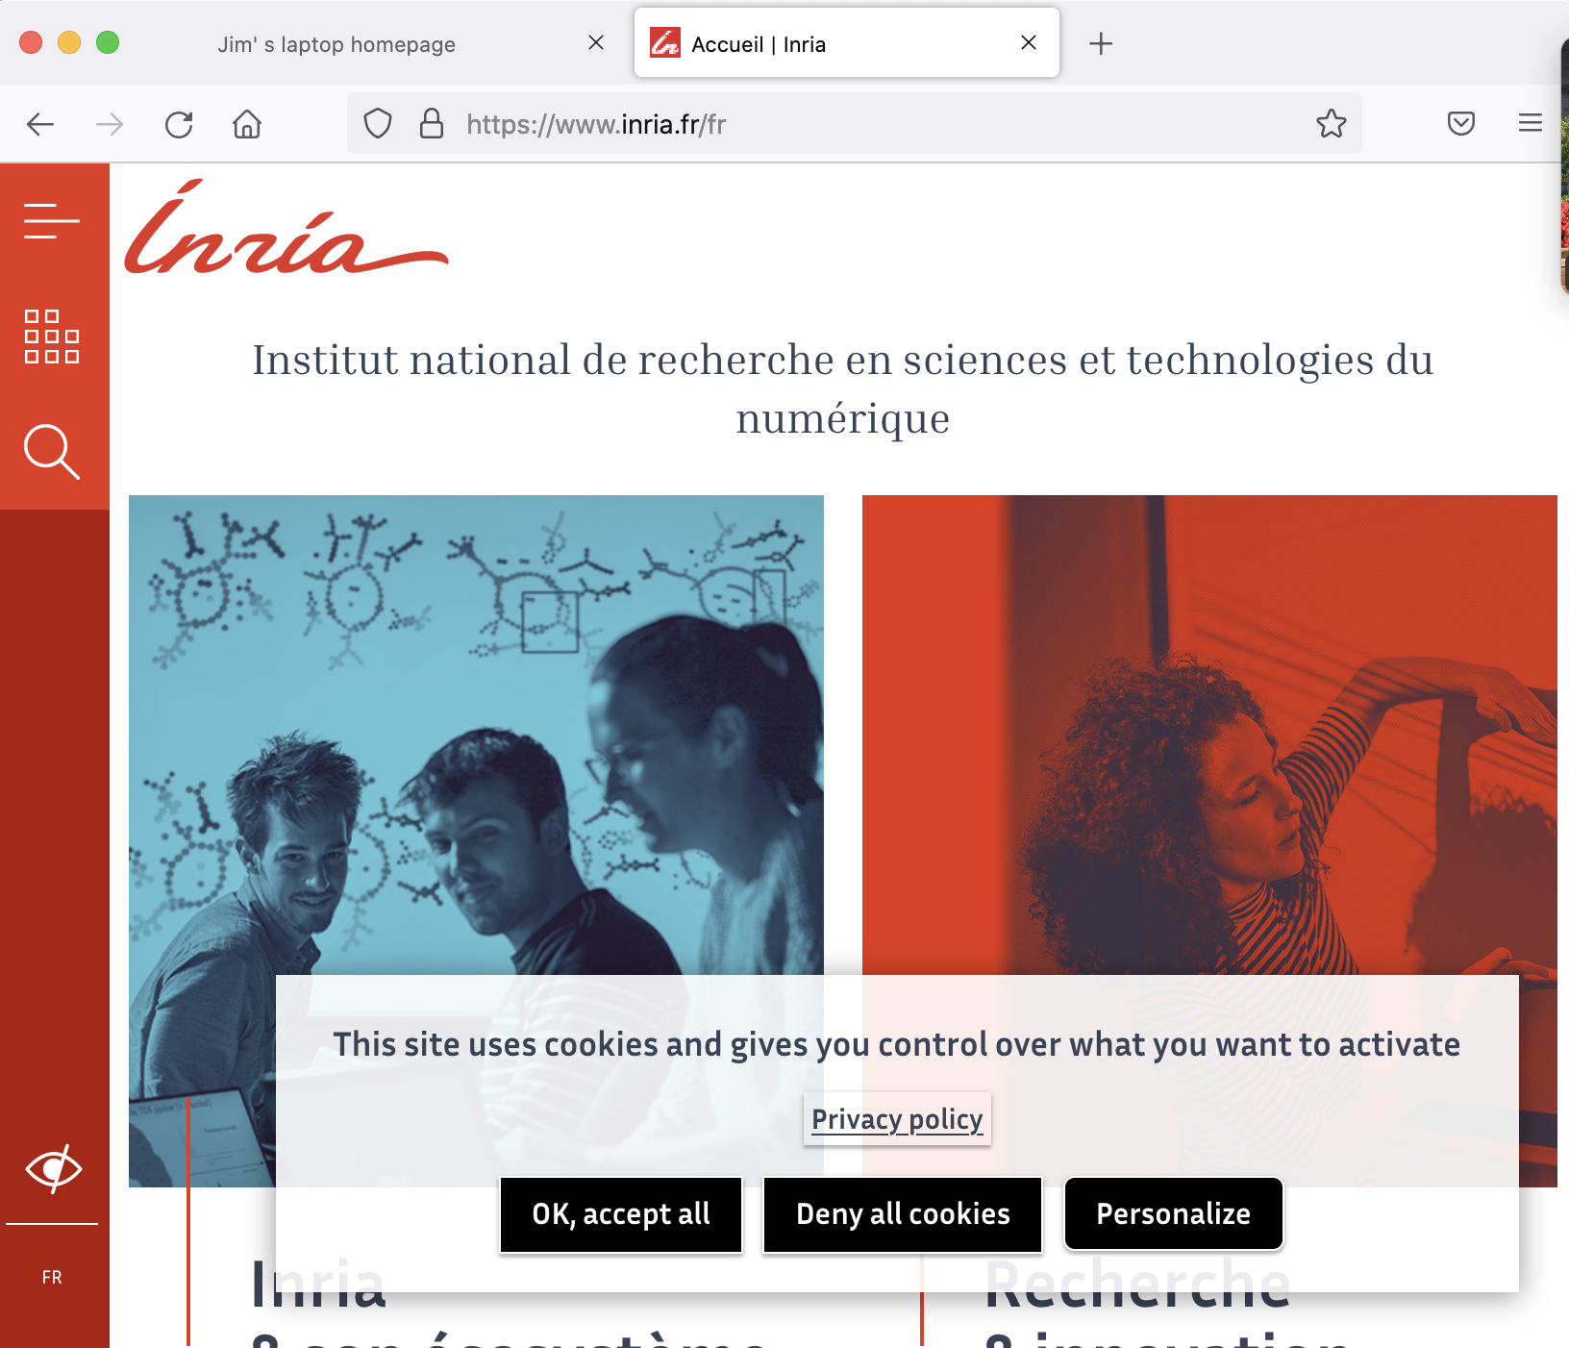
GDPR (EU General Data Protection Regulation) and cookies
“Natural persons may be associated with online identifiers […] such as internet protocol addresses, cookie identifiers or other identifiers […].
This may leave traces which, in particular when combined with unique identifiers and other information received by the servers, may be used to create profiles of the natural persons and identify them.”
GDPR, recital 30 (May 2018)
when cookies can identify an individual, cookies are considered personal data, subject to GDPR personal data regulations
User has explicit control over whether or not cookies are allowed

Slide 13
QUIZ

Slide 14
Quiz
What type of architecture does the Web's HTTP protocol follow?
Peer-to-Peer (P2P)
Client-Server
Hybrid
Ring-based

Slide 15
Quiz
On which default port number does an HTTP server listen for incoming TCP connection requests?
Port 21
Port 25
Port 80
Port 443

Slide 16
Quiz
Which transport layer protocol is used by HTTP to transmit messages?
UDP
IP
TCP
ICMP

Slide 17
Quiz
HTTP is considered a "stateless" protocol. What does this mean?
It encrypts all user sessions
The server maintains no information about past client requests
Connections are kept open indefinitely
The client never stores local cookies

Slide 18
Quiz
A Web page consists of a base HTML file and several referenced objects. How is each object uniquely addressed?
IP Address only
MAC Address
Uniform Resource Locator (URL)
Port Number

Slide 19
Quiz
Which HTTP method is used to upload a new file to a server, replacing the existing file at the specified URL?
POST
GET
HEAD
PUT

Slide 20
Quiz
What does RTT (Round Trip Time) measure?
The time required to transmit a complete file over a socket
The time taken for a small packet to travel from client to server and back
The total time spent parsing an HTML document
The server processing delay for a database query

Slide 21
Quiz
In non-persistent HTTP, how many objects can be sent over a single TCP connection at most?
Zero
At most one object
Exactly 10 objects
Unlimited objects

Slide 22
Quiz
Assuming zero transmission time for the file itself, what is the total response time to fetch a single object using non-persistent HTTP?
1 RTT
2 RTT
3 RTT
4 RTT

Slide 23
Quiz
How does persistent HTTP (HTTP 1.1) reduce web page retrieval times compared to non-persistent HTTP?
It compresses HTTP headers automatically
It reuses an open TCP connection for subsequent requests between the same client and server
It bypasses TCP three-way handshakes completely
It switches the transport layer protocol from TCP to UDP

Slide 24
Quiz
How can user input from a form be sent to a server when using the HTTP GET method?
In the entity body of the HTTP message
Included directly in the URL field following a ? symbol
Inside the User-Agent header
Via the TCP connection setup packet

Slide 25
Quiz
A user requests a web page containing a base HTML file and 10 referenced JPEG images using non-persistent HTTP without parallel TCP connections. How many total TCP connections must be created to fetch the entire page?
1 connection
10 connections
11 connections
20 connections

Slide 26
Quiz
Using the scenario in the previous question (base HTML file + 10 JPEG images with non-persistent HTTP and no parallel connections), ignoring transmission times, what is the total response time in terms of RTT?
11 RTT
20 RTT
22 RTT
2 RTT

Slide 27
Quiz
When Musa visits an e-commerce website for the first time, what sequence of events occurs regarding cookies?
His browser creates a cookie ID and sends it in the initial GET request header Cookie: ID
The server generates a unique ID, creates a backend database entry, and responds with Set-Cookie: ID
The server installs an application on Musa’s system to monitor local files
The client requests a static IP from the local ISP to maintain session state

Slide 28
Quiz
Why might non-persistent HTTP impose significant overhead on an operating system when downloading a Web page with many referenced objects?
The server must re-parse the base HTML file for every single request
A new TCP connection must be allocated and closed for every single object, creating OS memory and processing overhead
It requires setting up multiple cookies for each referenced image object
Non-persistent HTTP requires converting image formats to ASCII before transmission

